Slide 1
SE Tools and Practices
(SENG4144)
Arba Minch University
Institute of Technology
Faculty of Computing & Software Engineering
Addisu M. (Asst. Prof)
G4 it - Summer
Notes:
https://www.scribd.com/document/576561194/Chapter-1-new

Slide 2
Chapter 3
GRAPHICAL UI LAYOUT

Slide 3
Graphical user interface
GUI – type of UI that allows users to interact with electronic devices through graphical elements such as windows, icons, buttons, and menus, rather than text-based commands
  It makes easier for users to operate software and systems by providing a visual representation of tasks and data
    built from GUI components (buttons, menus, labels, text fields, etc)
    GUI component – an object with which the user interacts via mouse or keyboard
    gives an application a distinctive “look and feel”

Slide 4
Graphical user interface
The actions in a GUI are usually performed through direct manipulation of the graphical elements.
  Beyond computers, they are used in many handheld mobile devices, gaming devices, smartphones, office and industrial controls.
Building GUIs require use of GUI frameworks:
  JavaFX
  Older Java frameworks AWT and SWING
Classes that are used to create GUI components are part of java.awt or javax.swing package
    Both packages provide rich set of user interface components

Slide 5
Graphical user interface
Purpose:
  User-Friendly Interaction: simplify the interaction between users and devices, making technology more accessible to non-technical users.
  Visual Representation of Information: use visuals to represent data, making it easier for users to understand and manipulate information.
  Intuitive Navigation: allow users to navigate through software applications via familiar visual elements, reducing the learning curve.
  Enhanced Productivity: By providing quick access to tools and functions through visual elements, it can help users complete tasks more efficiently
  Feedback Mechanism: provide visual feedback (like highlighting or animations) that confirms user actions, enhancing overall user experience.
  Multitasking Support: often support multiple open windows and applications, allowing users to switch between tasks seamlessly.
  Aesthetic Appeal: A well-designed GUI can improve the overall aesthetic of an application, making it more enjoyable to use.

Slide 6
Graphical user interface
key concepts in GUI
User-Centered Design (UCD): Focus on the needs, preferences, and behaviors of users throughout the design process. Involve users in testing and feedback.
Affordances:
Design elements should suggest their function. For example, buttons should look clickable.
Usability:
Ensure that the interface is easy to use, learn, and remember. Prioritize efficiency and satisfaction.
Visual Hierarchy:
Use size, color, contrast, and spacing to highlight important elements and guide users’ attention through the layout.
Feedback:
Provide immediate and clear feedback for user actions, such as visual changes when buttons are clicked or forms submitted.
Consistency:
Maintain uniform design elements across the interface (fonts, colors, buttons) to create a familiar and intuitive experience.

Slide 7
Graphical user interface
key concepts in GUI
Accessibility:
Design with inclusivity in mind, ensuring the interface is usable by people with diverse abilities. Use proper contrast, text size, and alt text for images.
Navigation:
Create intuitive navigation structures that allow users to find information easily. Use clear labels and logical groupings.
Responsive Design:
Ensure the interface works well across different devices and screen sizes, adapting layouts and elements accordingly.
Whitespace:
Use whitespace effectively to reduce clutter, improve readability, and create a balanced layout.
Color Theory:
Utilize color strategically to evoke emotions, create contrast, and enhance the overall aesthetic while ensuring readability.
Typography:
Choose fonts that are legible and appropriate for the context. Maintain a hierarchy with font sizes and styles to guide users.

Slide 8
Processes
UI design requires a good understanding of user needs.
  It mainly focuses on the needs of the platform and its user expectations.
There are several phases and processes in UI design:
Functionality requirements gathering – assembling a list of the functionality required by the system to accomplish the goals of the project and the potential needs of the users.
User and task analysis – the analysis of potential users of the system by studying how they perform the tasks that the design must support, and conducting interviews to reveal their goals.
Information architecture – dev’t of the process and/or information flow of the system.

Slide 9
Processes
There are several phases and processes in UI design:
Prototyping – dev’t of wire-frames, either in the form of paper prototypes or simple interactive screens
Usability inspection – letting an evaluator inspect a UI.
  Some common usability inspection methods include
    cognitive walkthrough – focuses the simplicity to accomplish tasks with the system for new users and it is a formal method for evaluating the UI without the user
    pluralistic walkthrough – selected group of people step through a task scenario and discuss usability issues
Usability Testing - testing of the prototypes on an actual user—often using a technique called think aloud protocol where you ask the user to talk about their thoughts during the experience

Slide 10
Requirements
The dynamic characteristics of a system are described in terms of the dialogue requirements contained in seven principles of the ergonomics standard, ISO 9241.
This part of ISO 9241 presents a set of usability heuristics that applies to the interaction of people and information systems (the heuristics are based on an earlier German standard).
The standard refers to this interaction as a “dialogue” and describes seven “dialogue principles”.
The seven dialogue principles – dialogue principles for user friendly design are…
Notes:
ISO 9241 is an international standard that focuses on the ergonomics and usability of human-computer interaction. It provides guidelines and principles for designing user-friendly interfaces and ensuring that they meet user needs effectively.

Slide 11
Requirements
Seven dialogue principles – are …
  Suitability for the task – dialogue should be suitable for the user’s task and skill level. It describes how reasonable something is in order to complete a specific task.
  Self-descriptiveness – dialogue should make it clear what the user should do next.
    At any time, users are aware what is happening and how to interact with the object or interface.
    Ultimate goal: a product explains itself without the need of any instructions or written hints for its users.
  Controllability – user should be able to control the pace and sequence of the interaction.
    Users should always be in control of their interactions with the system
    They start, pause or cancel an action, according to their individual preferences.

Slide 12
Requirements
Seven dialogue principles – are …
  Conformity with user expectations – should be consistent.
    describes to which extent an interaction with a product reflects what the user expected
    If something does not happen in the way the user expected, the user gets upset
  Error tolerance – dialogue should be forgiving
    Error tolerance means that a product reacts to user’s errors.
    If possible, the product corrects occurring errors independently autonomously.
    If this is not feasible, the product informs the user and allows easy error correction, while supporting the user as far as possible.

Slide 13
Requirements
Seven dialogue principles – are …
  Suitability for individualisation – dialogue should be able to be customised to suit the user
    users can adapt the product to their own needs
  Suitability for learning – dialogue should support learning
    When it is necessary to learn how to use certain functions of a product, this should be as easy as possible.
    Metaphors and help dialogues guide the user, in order to reduce learning time.

Slide 14
Abstract Window Toolkit (AWT) Packages
AWT contains classes for graphics, and also defines the basic graphical UI framework for Java
Java AWT is an API to develop GUI or window-based applications in java.
java.awt package contains the core AWT graphics classes:
GUI Component classes, such as Button, TextField, and Label.
GUI Container classes, such as Frame and Panel.
Layout managers, such as FlowLayout, BorderLayout and GridLayout.
Custom graphics classes, such as Graphics, Color and Font.

Slide 15
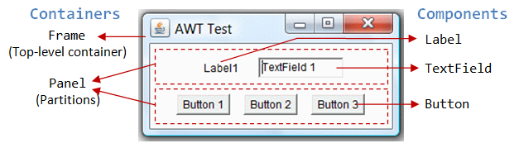
Abstract Window Toolkit (AWT) Packages
Containers and Components
There are two types of GUI elements:
Component: elementary GUI entities, such as Button, Label, and TextField
Container: such as Frame and Panel, are used to hold components in a specific layout (such as FlowLayout or GridLayout).

Slide 16
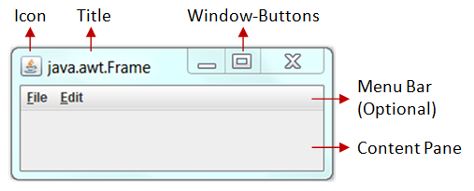
Abstract Window Toolkit (AWT) Packages
AWT Container Classes
Each GUI has a top level container. The commonly used are Frame, Dialog, and Applet
Frame provides "main window" for your GUI application.
  has title bar (containing icon, title, minimize, maximize/restore-down and close buttons), an optional menu bar, and content display area.

Slide 17
Abstract Window Toolkit (AWT) Packages
Secondary Containers: Panel and ScrollPane
  placed inside a top-level container or another secondary container
    Panel: a rectangular box used to layout a set of related GUI components in pattern such as grid or flow.
    ScrollPane: provides automatic horizontal and/or vertical scrolling for a single child component.

Slide 18
UI Components
Label
  can be used to display text and/or icon.
  a passive component – does not respond to user input
  Constructors:
        JLabel(Icon icon);
        JLabel(String str);
        JLabel(String str, Icon icon, int align)
      Icon & str → icon and text used for label
          To obtain an icon, and object of ImageIcon class has to be passed as an argument to the Icon parameter.
      Align → horizontal alignment of the text/and or icon
          must be one of the ff values: LEFT, RIGHT, CENTER

Slide 19
UI Components
Button
  Functionality of a push button
  An icon/string or both can be associated with a button
  Constructors
        JButton(Icon str)
        JButton(String str)
        JButton(String str, Icon icon)
  Creation of JButton: JButton jb = new JBtton(label);
  Event Generated:
      when button is pressed ActionEvent object is generated
      To deal with the event, implement ActionListener interface, register the listener and define the method public void actionPerformed(ActionEvent)

Slide 20
UI Components
CheckBox
allows to select multiple item from group
    Any number of check boxes in a group — none, some, or all — can be selected
    Creation of JCheckBox:
          JCbeckBox jcb = new JCheckBox();
          JCbeckBox jcb = new JCheckBox(Label);
          JCbeckBox jcb = new JCheckBox(Label,boolean);
  Event Generated:
      It generates one item event and one action event per click
      Creates ItemEvent Object;
          Register with ItemListener interface;
          Implement void itemStateChanged()

Slide 21
UI Components
RadioButton
  groups of buttons in which, by convention, only one button at a time can be selected
  Swing release JRadioButton and ButtonGroup classes
    Creation of JRadioButton:
        JRadioButton jrb = new JRadioButton();
        JRadioButton jrb = new JRadioButton(Label);
        JRadioButton jrb = new JRadioButton(Label,boolean);
ButtonGroup: used to place multiple buttons into a single group in which only one button at a time can be selected
    Creation of ButtonGroup:
    ButtonGroup bg = new ButtonGroup();
      use add method to include JRadioButton objects in group bg.add(jrb);

Slide 22
UI Components
ComboBox
  choose one of several choices; can have two different forms
      uneditable combo box – features button & drop-down list of values
      editable – features text field with small button abutting it
          user can type a value in the text field or click the button to display a drop-down list
  Swing provides a combo box (a combination of a text field and a drop-down list) through the JComboBox class
  Constructors: JComboBox() & JComboBox(Object[])
  Items are added to list of choices via addItem( ) method,
        jcb.addItem(item);
        obj is the object to be added to the combo box
Creation of JComboBox: JComboBox jcb = new JComboBox();

Slide 23
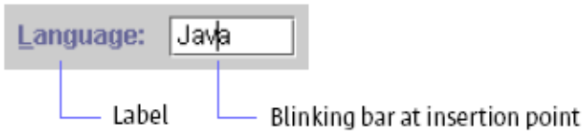
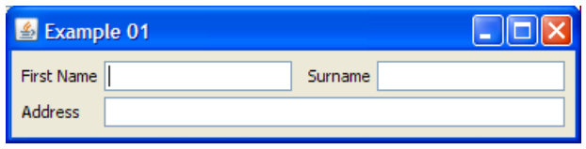
UI Components
TextField
  used to enter or display a string
JTextField firstName = new JTextField(20);
JTextField surName = new JTextField(20);
JTextField address = new JTextField(60);
add(firstName);
add(surName);
add(address);

Slide 24
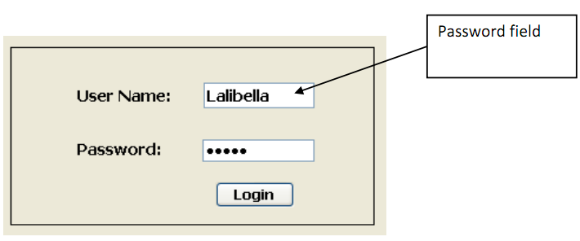
UI Components
PasswordField
JPasswordField userName = new JPasswordField(20);
JFrame f=new JFrame(“Example 01”);
f.add(userName);//adds the password field to a container

Slide 25
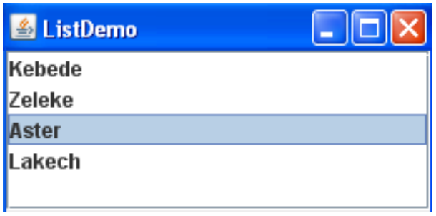
UI Components
List
  A list is a component that basically performs the same function as a combo box, but it enables the user to choose a single value or multiple values.
    String[] str = {“Kebede", “Zeleke", “Aster", “Lakech"};
    JList list=new JList(str);
    JPanel p=new JPanel();
    p.add(list);

Slide 26
Layout Management
a crucial aspect of UI design, focusing on the arrangement and organization of visual elements within a UI
Effective layout management enhances usability, accessibility, and overall user experience
Layout Managers and Panel
essential components in GUI design and dev’t, especially in frameworks like Java Swing, Android, and others
container has layout manager to arrange its components

Slide 27
Layout Management
Common Layout Managers
  Flow Layout - default layout
    arranges components in a left-to-right flow, similar to text
    components wrap to the next line when container is full
    Simple and ideal for small applications
Constructors:
  public FlowLayout();
  public FlowLayout(int alignment);
  public FlowLayout(int alignment, int hgap, int vgap);
  // alignment: FlowLayout.LEFT, FlowLayout.RIGHT, or FlowLayout.CENTER
  // hgap, vgap: horizontal/vertical gap between the components
  // by default: hgap = 5, vgap = 5, alignment = FlowLayout.CENTER

Slide 28
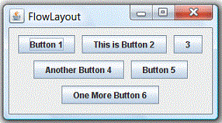
Layout Management
Common Layout Managers
  Flow Layout
    In java.awt.FlowLayout, components are arranged from left-to-right inside the container in the order that they are added (via method aContainer.add (aComponent)).
    When one row is filled, a new row will be started.
    actual appearance depends on the width of the display window.

Slide 29
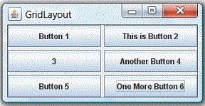
Layout Management
Common Layout Managers
  Grid Layout
    arranges components in rectangular grid of rows & columns
    Each cell (rectangular) can contain one component
    Useful for forms and structured layouts
    java.awt.GridLayout components are arranged in a matrix inside the Container
    Components are added in a left-to-right, top-to-bottom manner in the order they are added (via aContainer.add (aComponent))
    Constructors
        public GridLayout();
        public GridLayout(int rows, int columns);
        public GridLayout(int rows, int columns, int hgap, int vgap);
        // by default: rows = 1, cols = 1, hgap = 0, vgap = 0

Slide 30
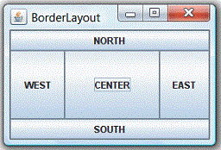
Layout Management
Common Layout Managers
  Boarder Layout
    divides container into five regions: North, South, East, West, and Center
    Useful for creating a layout with header, footer & side panels
    Constructors
        public BorderLayout();
        public BorderLayout(int hgap, int vgap);
        // by default hgap = 0, vgap = 0
    java.awt.BorderLayout, components are added using method
    aContainer.add (aComponent, zone),
    where zone is either BorderLayout.NORTH, BorderLayout.SOUTH, BorderLayout.WEST, BorderLayout.EAST, or BorderLayout.CENTER

Slide 31
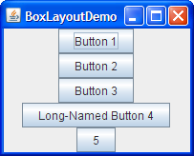
Layout Management
Common Layout Managers
  Box Layout
    arranges components either vertically or horizontally.
    components can be aligned at the start, center, or end.
    Ideal for simple linear arrangements
    has a single constructor:
public BoxLayout(Container target, int axis)
          first argument is the container
          second is the layout direction

Slide 32
Event Handling
  Events – actions usually triggered by user when interacting with application
      E.g., buttons, menus, sliders, mouse clicks, ... all generate events when the user does something with them.
  Events:
      Moving the mouse
      Clicking the button
      Press a button
  import Statements: to use events, you must import:-
      import javax.swing.*;
      import javax.swing.event.*;

Slide 33
Event Handling
  Event handling – mechanism that controls event and decides what should happen if an event occurs
      activity of capturing events and take appropriate action as per requirements (e.g. Print a message)
      code (known as event handler) that is executed when an event occurs
Steps to Handle Event in Java
    Whenever the user clicks the button an event is generated
    The object of the concerned event class will be automatically created and information about the source and the event gets populated within the same object
    Event object is forwarded to the method of registered listener class
    Method will get executed and returned

Slide 34
Event Handling
  To perform any operation, component has to listen to the event that is generated
      But the component can not listen to the events that are generated
      So, take the help of the listeners which are interfaces which can listen to the events that are generated
      After the listener listens, it delegates (passes) the event information to one of the method available in that listener
      This process is called as “Event Delegation Model”
          Once the event is generated, then the event is passed to other objects which handle the event, thus the term event delegation.

Slide 35
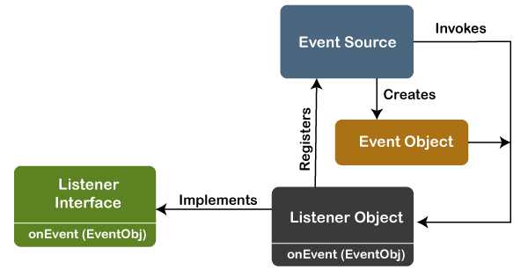
Event Handling
  Event Delegation Model has three parts:
    Events
    Events Sources
    Events Listeners

Slide 36
Event Handling
  Event Delegation Model has three parts:
    Events
        changes that we make when interacting with appln
            objects that define state change in a source
        an action that occurs within a GUI, such as a button click, a key press, or a mouse movement
            triggered either by external user actions (e.g., mouse mov’ts, button clicks and keystrokes) or by internal program activities (timer)
        When an event is triggered, it is typically handled by an event listener or handler, which is registered to the graphical component that generates the event

Slide 37
Event Handling
  Event Delegation Model has three parts:
    Events Sources
        an object (such as button, text field, or menu item, timers,…) that generates an event
        When an event is triggered on an event source, the event is encapsulated in an event object and passed to all the registered event listeners or handlers
        Event source is responsible for notifying the event listeners or handlers of the event and providing them with the information they need to handle the event
    Events Listeners – also known as event handler
        object that is registered to event source
        responsible for handling events that are generated
              Waits until it receives an event
              Once the event is received, listener process the event and then returns

Slide 38
Event Handling
  Event Delegation Model has three parts:
    Events Listeners – also known as event handler
        When event occurs on source, event listener is notified and performs the necessary actions to respond to event
        Event listener is typically implemented as a class that implements a specific event listener interface, such as ActionListener, MouseListener, or KeyListener
        Each interface specifies a set of methods that the event listener must implement to handle the event
            E.g., ActionListener interface requires the implementation of a single method called actionPerformed, which is called when an action event occurs on the event source

Slide 39
Tools and technologies
Tools and technologies used in GUI design and dev’t
Design Tools
Figma: collaborative interface design tool that allows for real-time editing and prototyping.
  Vector graphics, prototyping, design systems, and plugins.
Adobe XD: A vector-based design tool for creating user interfaces and user experiences.
  Wireframing, prototyping, and collaboration tools.
Sketch: vector graphic design tool primarily used for UI design
  Symbols, artboards, and extensive plugin support.

Slide 40
Tools and technologies
Tools and technologies used in GUI design and dev’t
Design Tools
InVision: A digital product design platform for prototyping and collaboration.
  Interactive prototypes, feedback tools, and design handoff
Axure RP: A wireframing and prototyping tool for creating complex interactive designs.
  Conditional logic, dynamic content, and collaboration features.

Slide 41
Tools and technologies
Tools and technologies used in GUI design and dev’t
Development Tools
Visual Studio Code: A lightweight code editor with support for numerous programming languages and extensions.
  Integrated terminal, debugging, and version control.
Webflow: A no-code platform for designing and developing responsive websites
  Visual design tools, CMS, and hosting.
React: A JavaScript library for building user interfaces, particularly single-page applications.
  Component-based architecture, virtual DOM, and hooks

Slide 42
Tools and technologies
Tools and technologies used in GUI design and dev’t
Development Tools
Angular: A platform for building mobile and desktop web applns using TypeScript.
  Two-way data binding, dependency injection, and modular architecture
Flutter: UI toolkit for building natively compiled applns for mobile, web, and desktop from a single codebase.
  Hot reload, rich set of widgets, and responsive design.

Slide 43
Any Question
???

